Slide 1

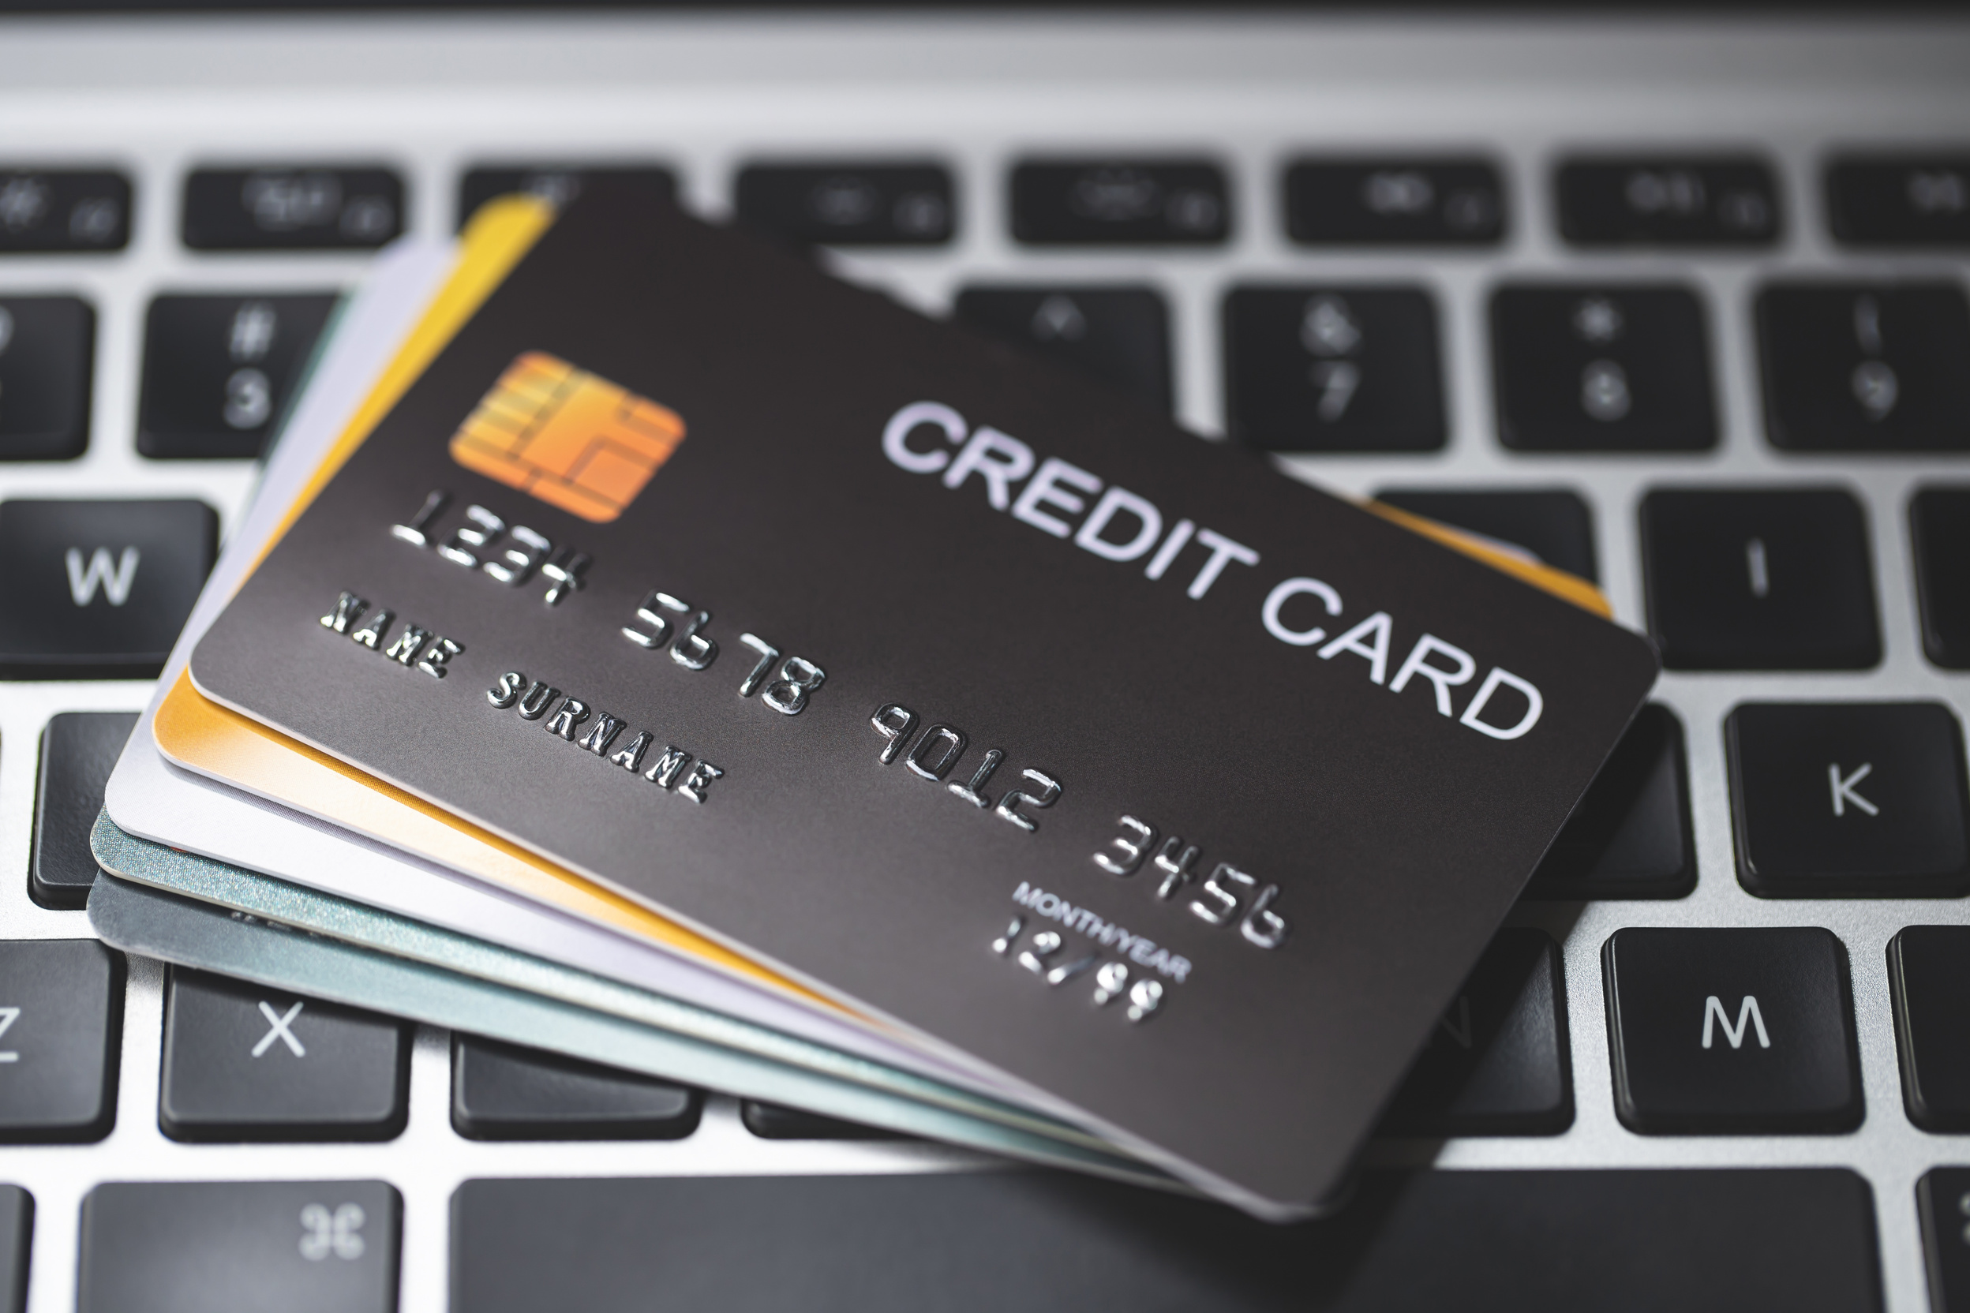



Credit Card
CREDIT CARD
DATA ANALYSIS
Presented By:
Niroj Lawati

Slide 2



ABOUT PROJECT
This project focuses on analyzing credit card data to uncover key insights into customer behavior, spending patterns, and business performance.
The analysis utilizes structured data stored in a relational database, with tables for customers, credit cards, and transactions. The project aims to deliver valuable insights for decision-making, such as identifying high-value customers, understanding spending trends, and improving risk management.

Slide 3
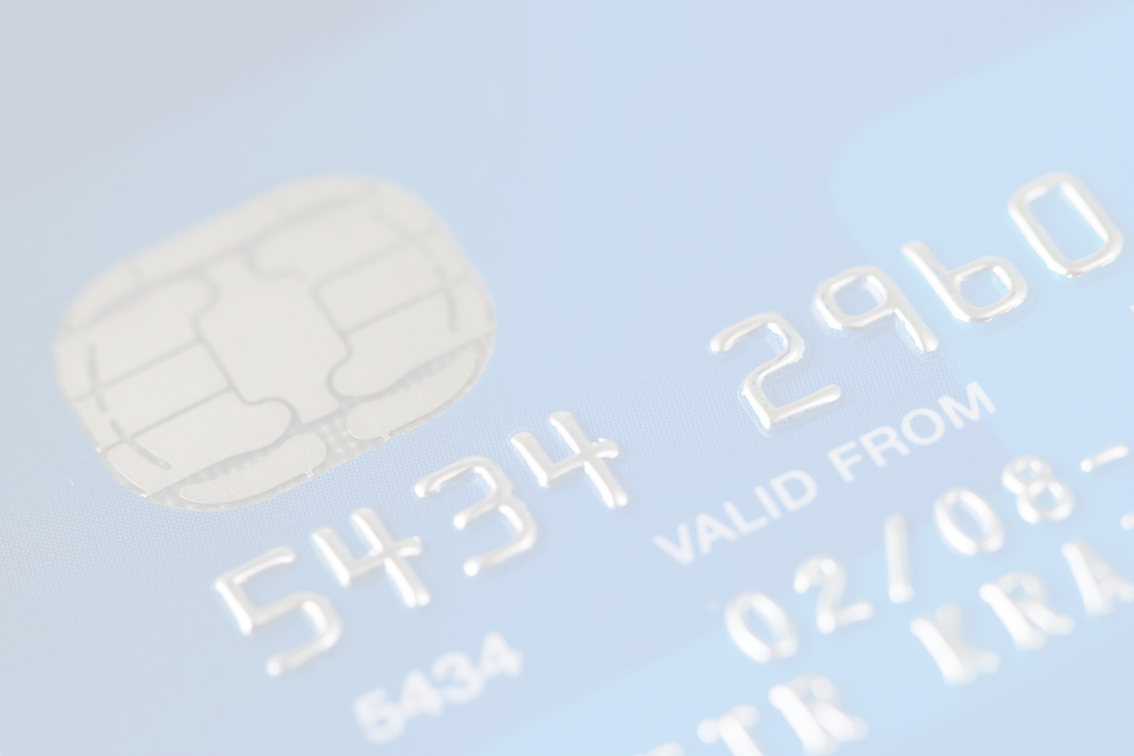
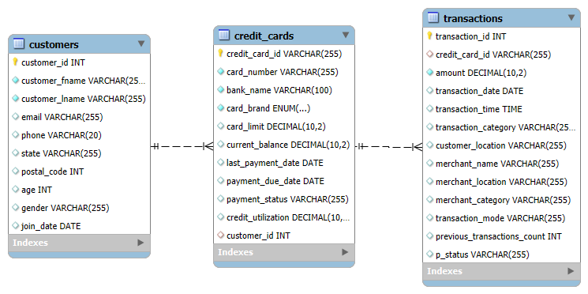
ER DIAGRAM

Slide 4


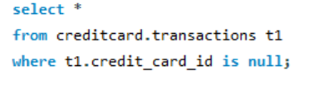
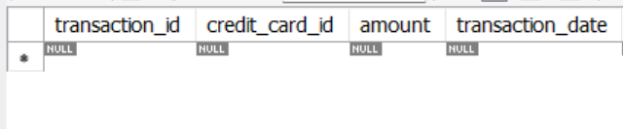
FIND TRANSACTIONS WHERE CREDIT_CARD_ID IS MISSING.

Slide 5

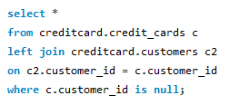
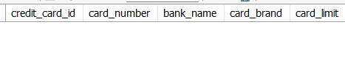
2. IDENTIFY CREDIT CARDS THAT REFERENCE A NON-EXISTING CUSTOMER.

Slide 6


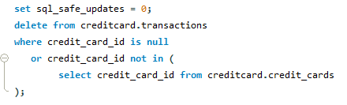
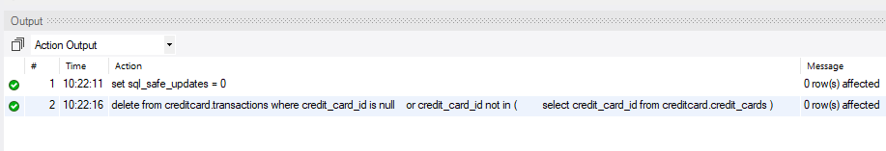
3. DELETE TRANSACTIONS WITH A MISSING OR INCORRECT CREDIT_CARD_ID.

Slide 7
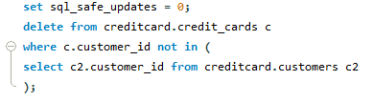
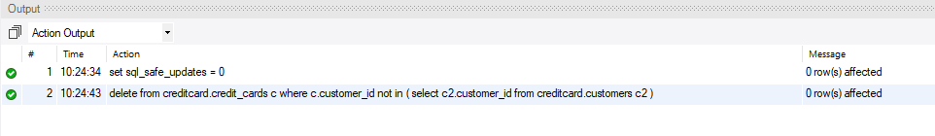
4. REMOVE CREDIT CARDS LINKED TO CUSTOMERS WHO DON’T EXIST IN THE
CUSTOMER TABLE.

Slide 8
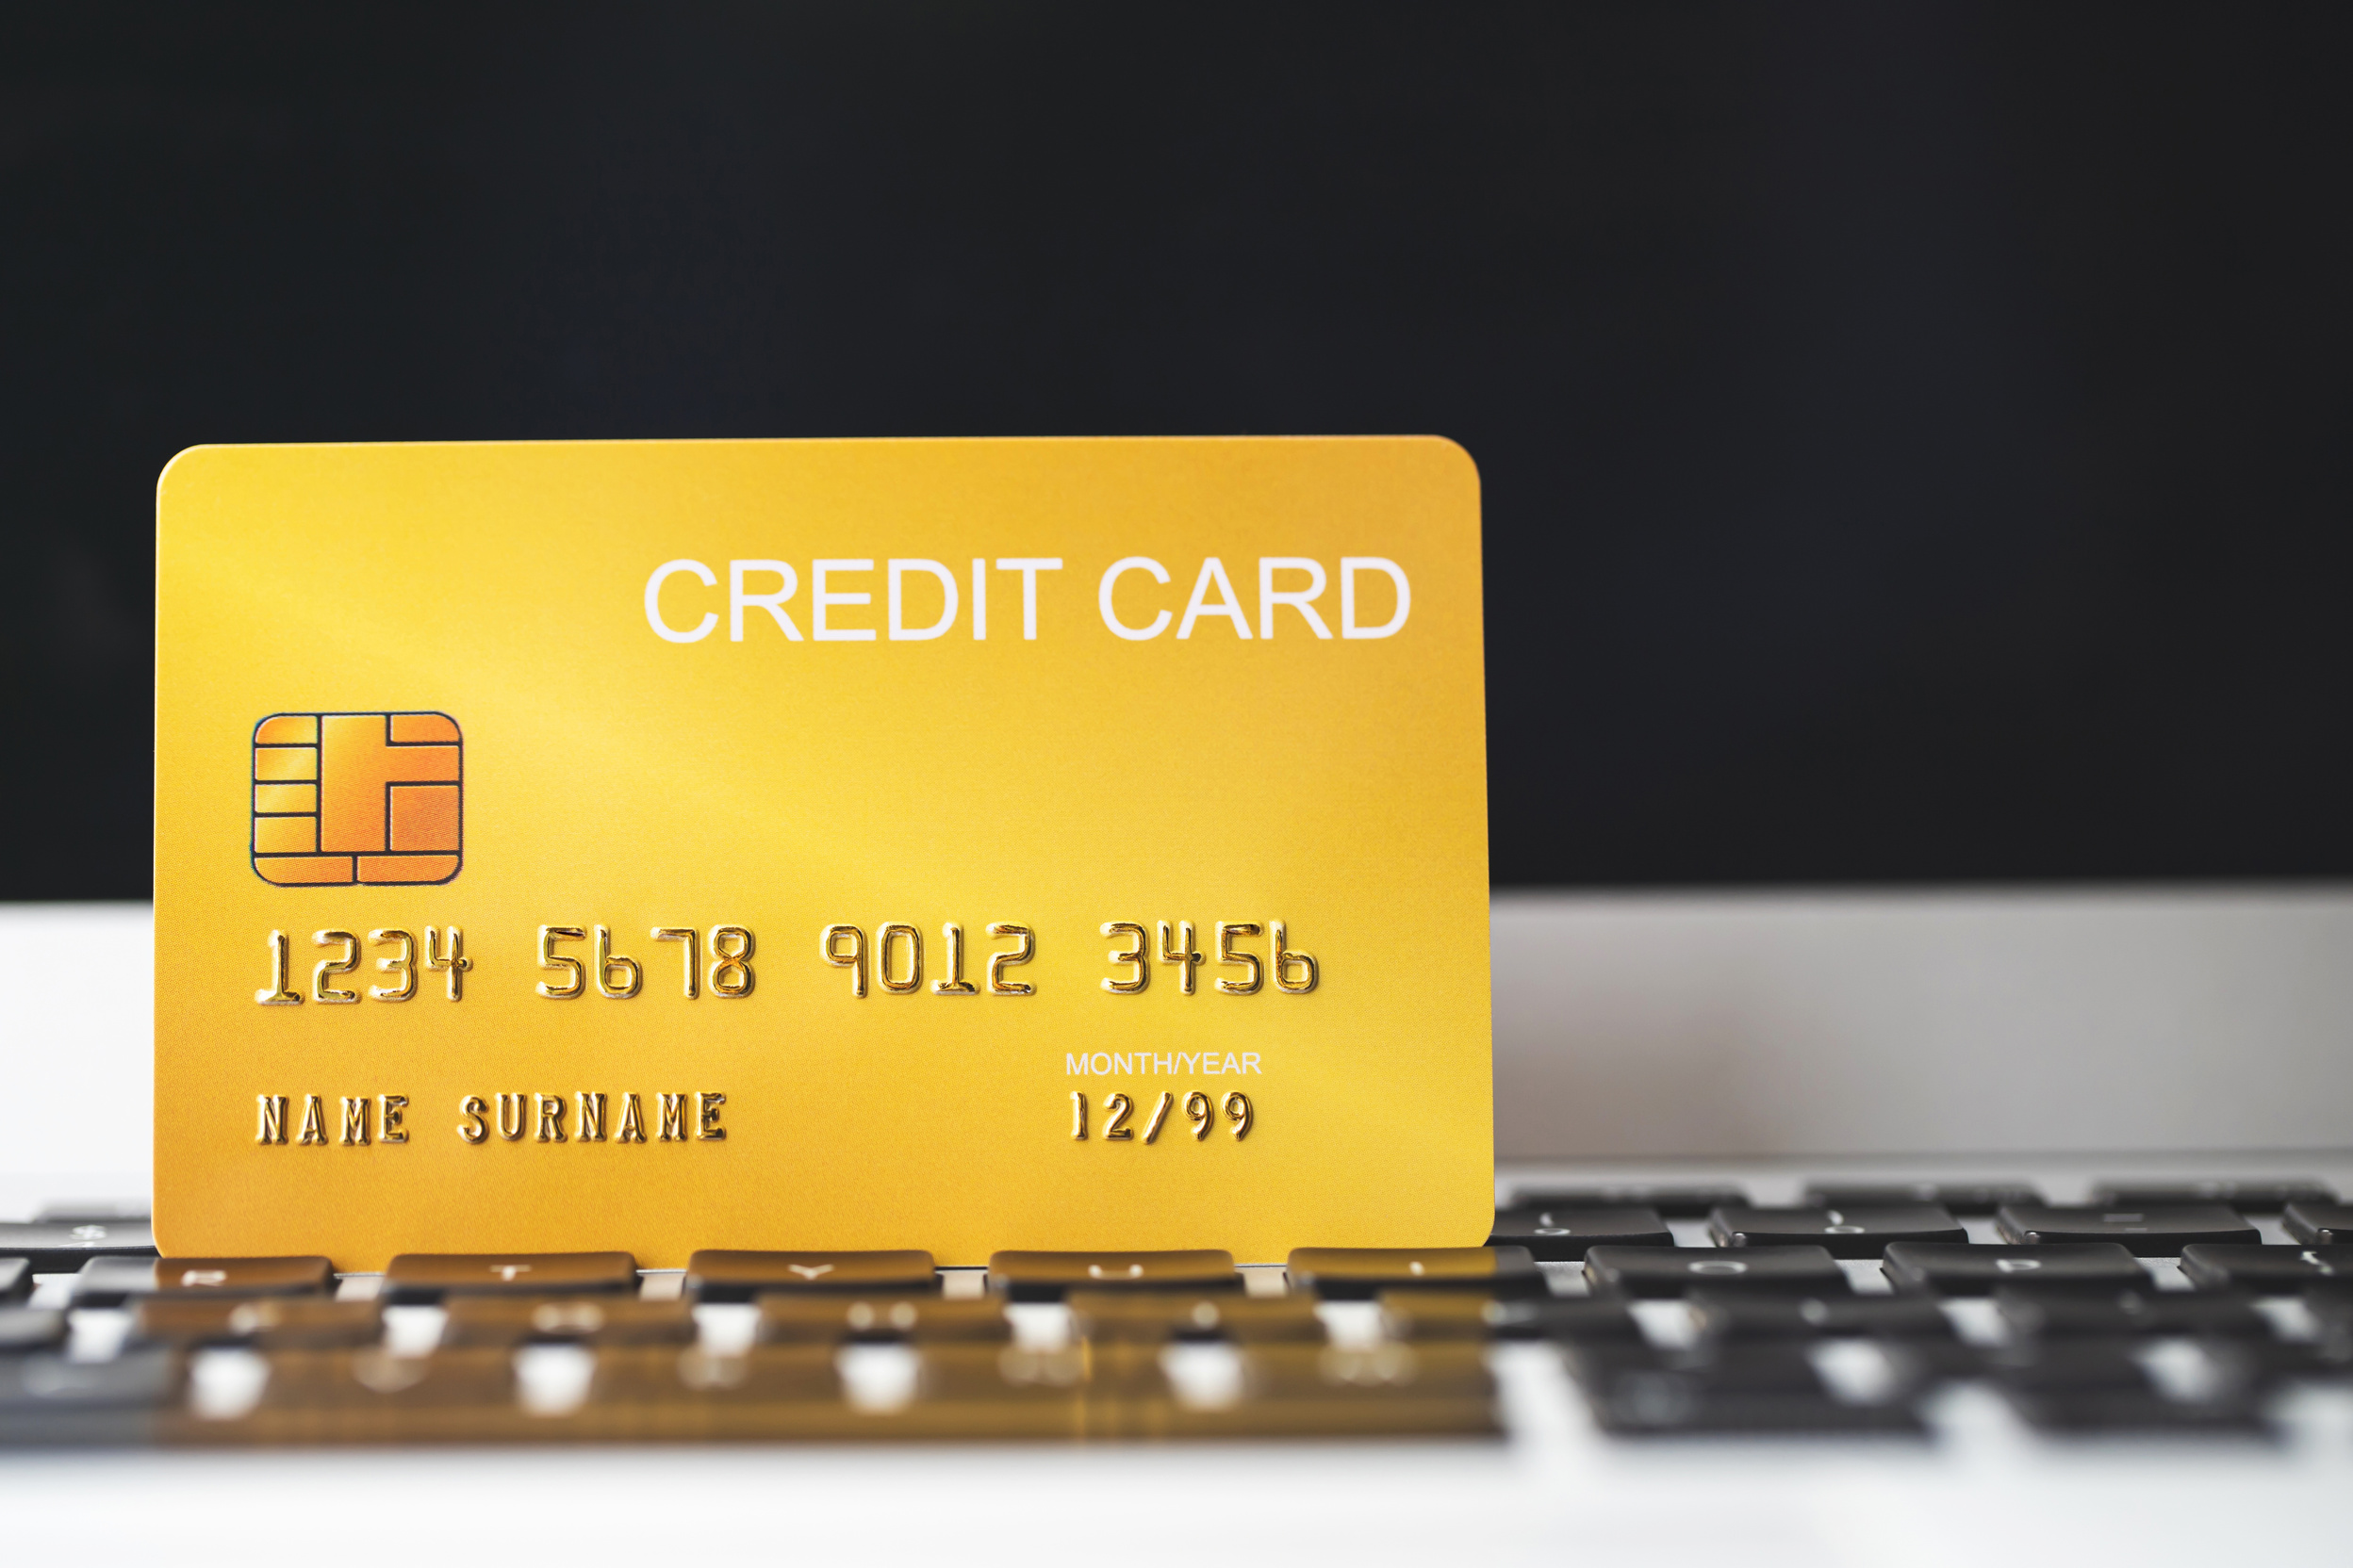
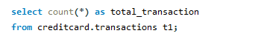
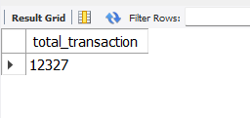
5. TOTAL NUMBER OF TRANSACTION

Slide 9
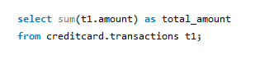
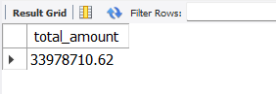
6. WHAT IS THE TOTAL AMOUNT SPENT?

Slide 10
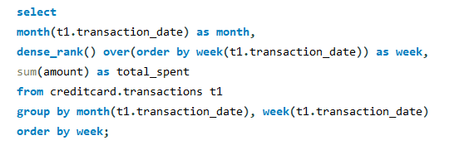
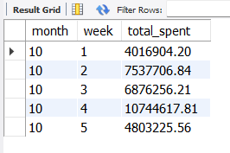
7. HOW DOES SPENDING CHANGE MONTH BY MONTH?

Slide 11

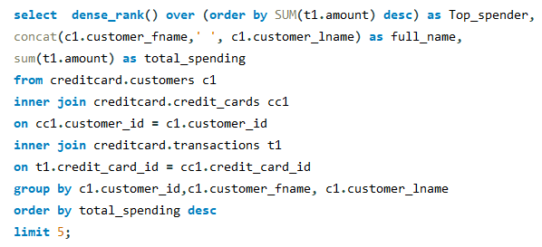
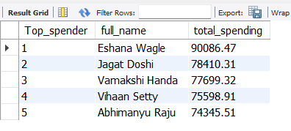
8. THE TOP 5 CUSTOMERS BY TOTAL SPENDING

Slide 12

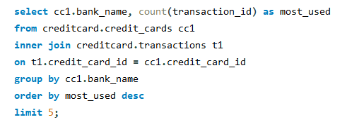
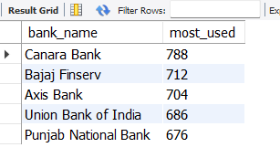
9. WHICH BANK’S CREDIT CARDS ARE USED THE MOST?

Slide 13
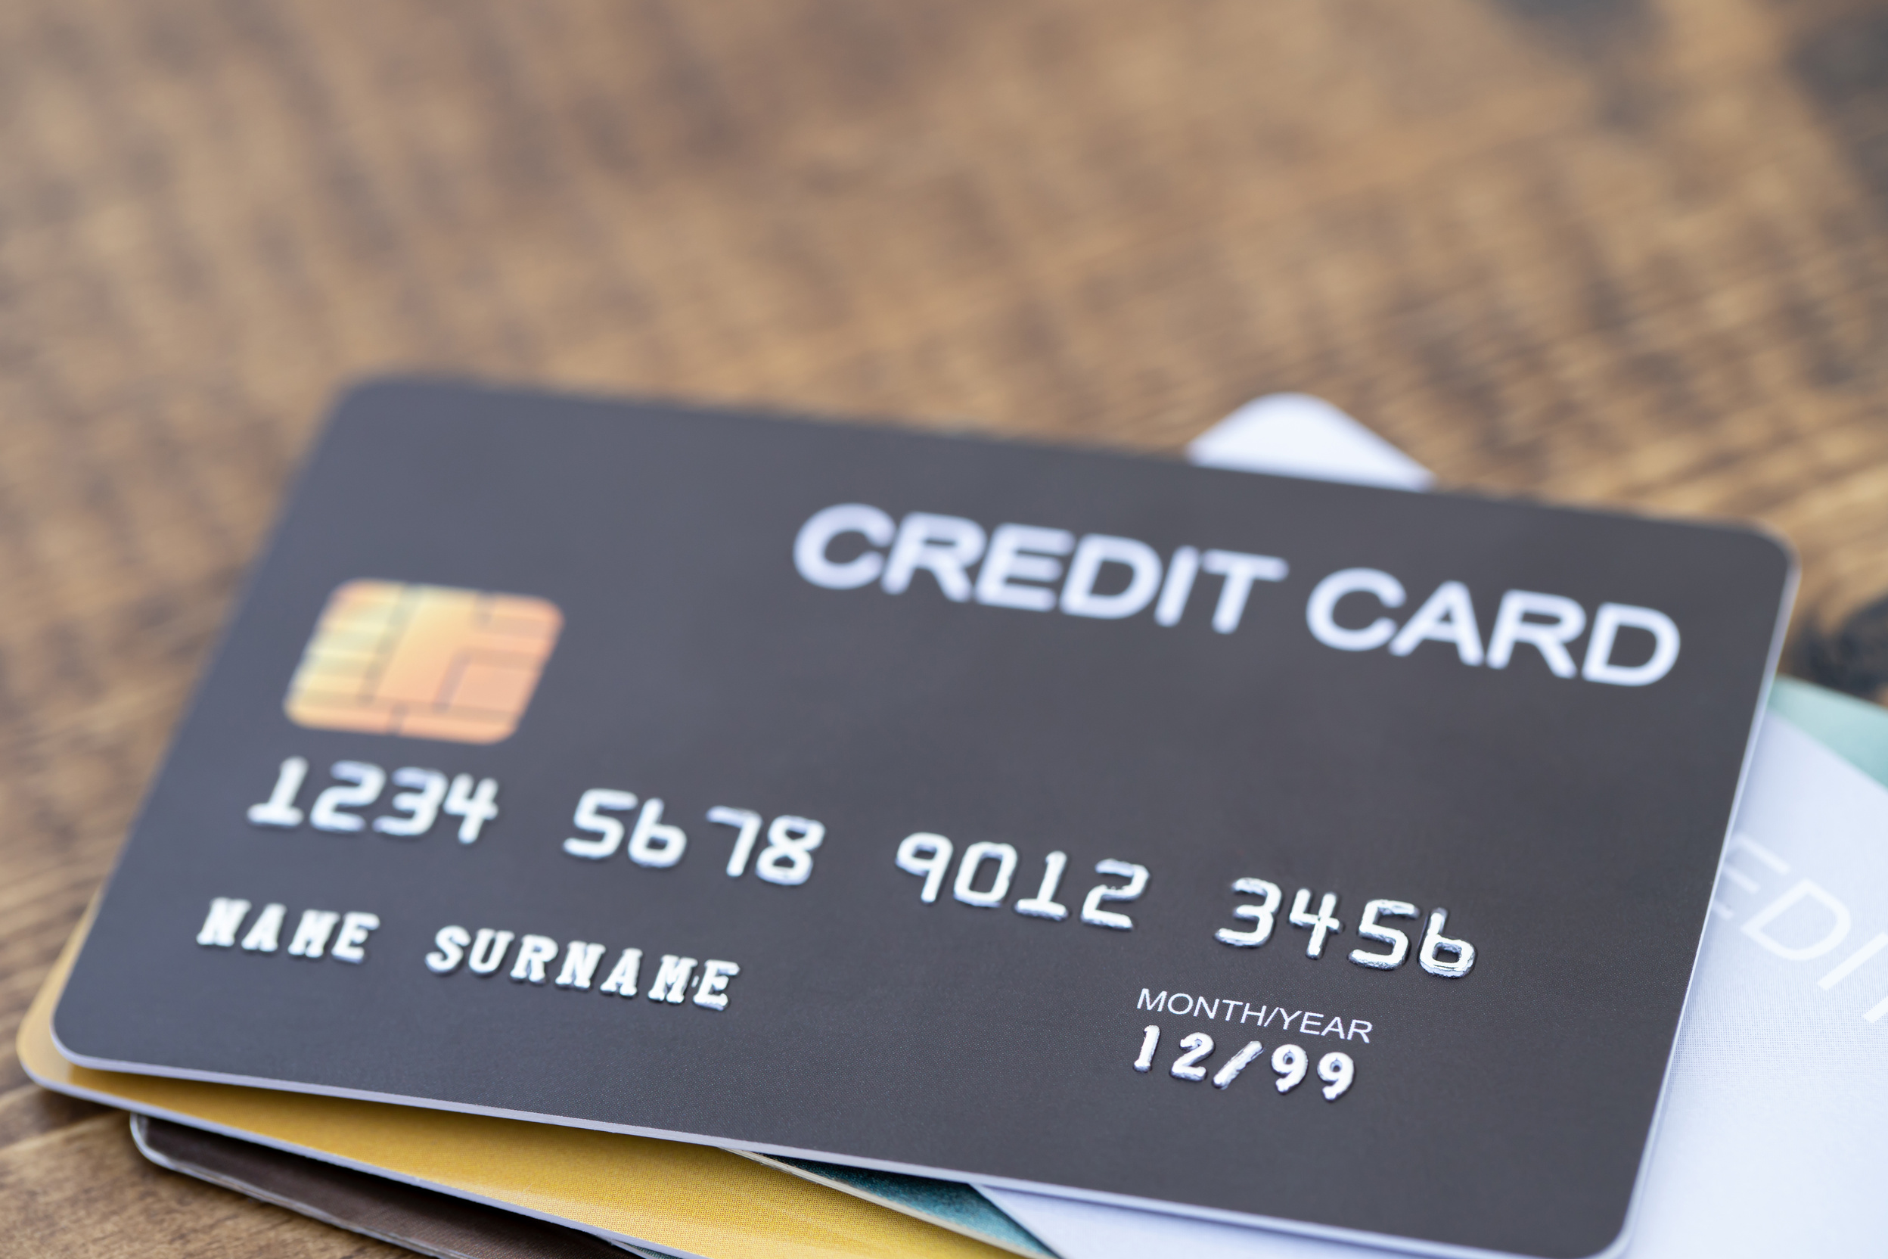
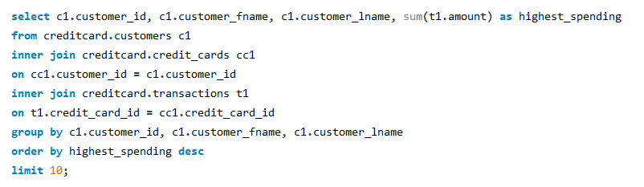
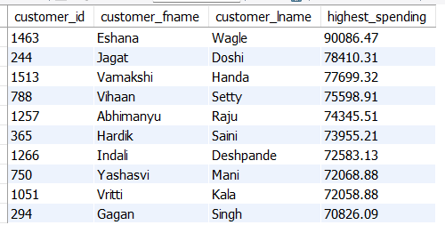
10. BIG SPENDERS: - CUSTOMERS WITH THE HIGHEST SPENDING

Slide 14

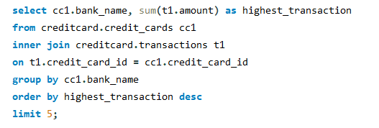
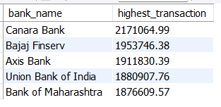
11. BANKS WITH THE HIGHEST TRANSACTIONS CAN ATTRACT MORE CUSTOMERS.

Slide 15
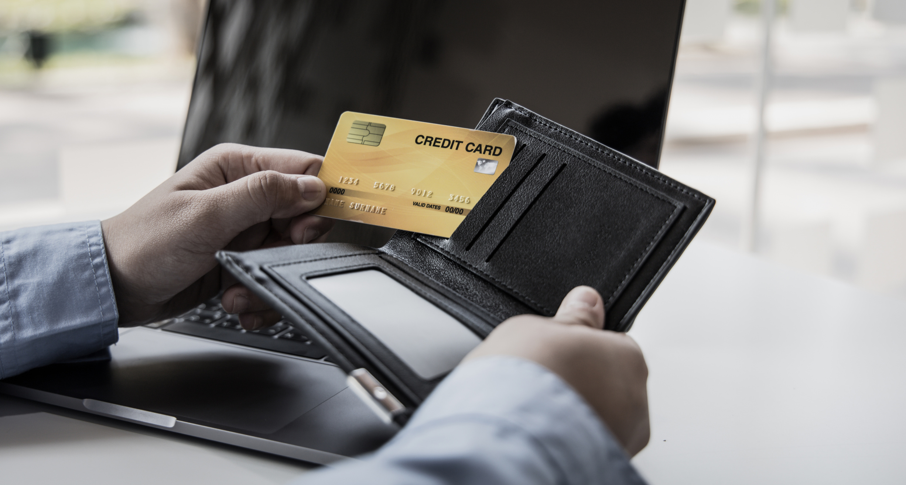
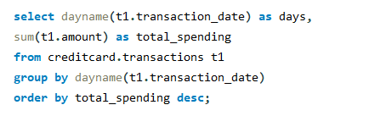
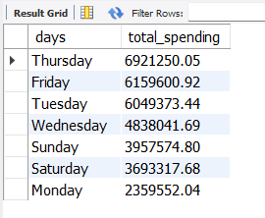
12. IDENTIFYING PEAK SPENDING TIMES CAN HELP IN MARKETING AND PROMOTIONS.

Slide 16

Credit Card
THANK YOU

